Slide 1
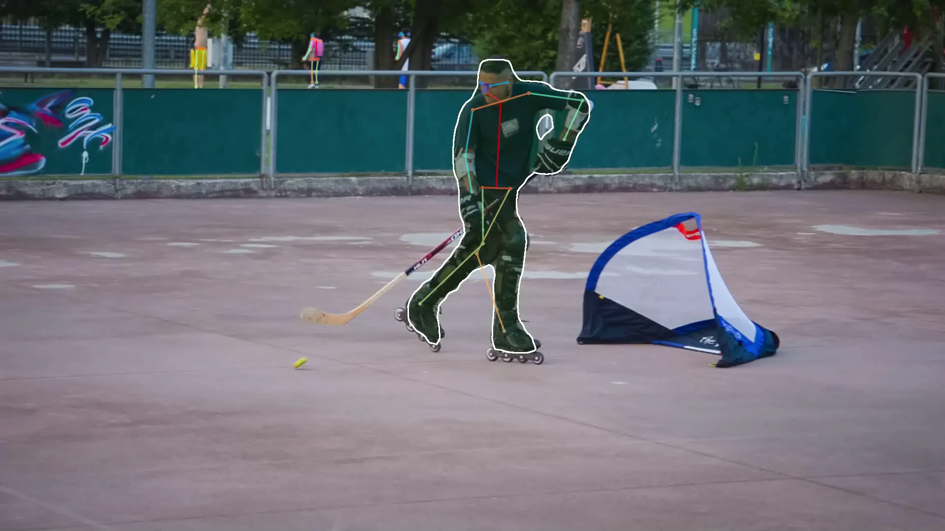

Slide 2
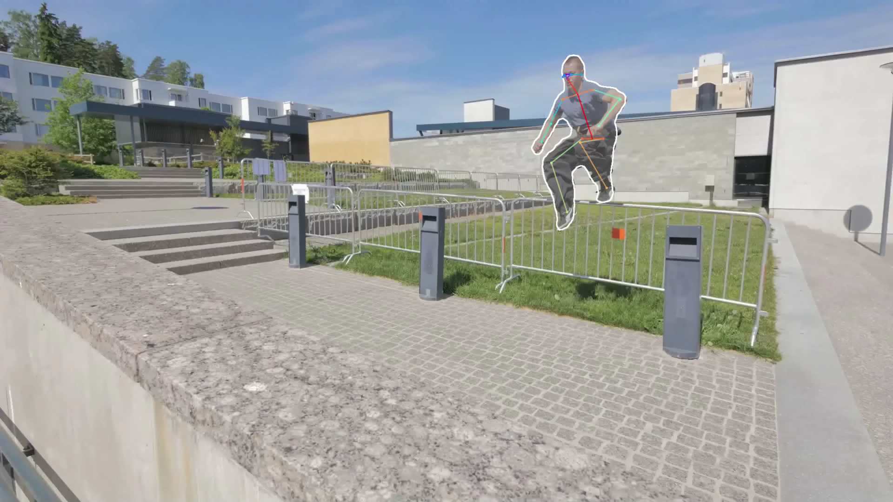

Slide 3
Recipe: Mask R-CNN at 45% box AP on COCO
Backbone FCN
ResNeXt-152-32x8d + Feature Pyramid Network (FPN)
Pre-trained on ImageNet-5k
Mask R-CNN training
15 epoch training schedule
End-to-end training
Data augmentation: left/right flip, scale jitter
Mask head same as paper
Some improvements can boost the single model to 48% box AP (see upcoming COCO Challenge workshop)

